Slide 1
Defensive Security Project
by: Carson Neidert

Slide 2
Table of Contents
This document contains the following resources:
Monitoring Environment
Attack Analysis
Project Summary & Future Mitigations

Slide 3

Monitoring Environment
‹#›

Slide 4
Scenario
In this project scenario, we will be analyzing the Windows logs, Windows attack logs, Apache logs, and Apache attack logs and will be creating reports for suspicious activities that we analyzed by using the fields located in each log file to determine what we deem suspicious. Afterwards we will create alerts for each field (severity field, http method field, etc) to review after we load the attack file then we will determine baselines and thresholds for our alerts that we create. We will then create dashboards to create visualizations of our fields and analyze to check for suspicious activity for the regular and attack files.

Slide 5
Website Monitoring
‹#›

Slide 6
Website Monitoring
Summary
The Website Monitoring Add-On App for splunk allows splunk users the capability of website monitoring to detect downtime and performance problems of the websites being looked at. The websites can be looked at by creating inputs of the websites, which can be done in as easy as 5 minutes. From there you can begin utilizing the different monitoring features as listed below and many more.
Features (from splunkbase website)
Uptime Calculation: the Status History dashboard provides information about past failures and calculates the website's uptime percentage
Status Monitoring Dashboard: provides the response time for your monitored websites and provides a historical analysis of the site's responsiveness
Email Outage Alerting: get an emailed alert when your website is down (responds too slowly or is returning an error)
Change History Dashboard: provides information regarding when the monitored pages change

Slide 7
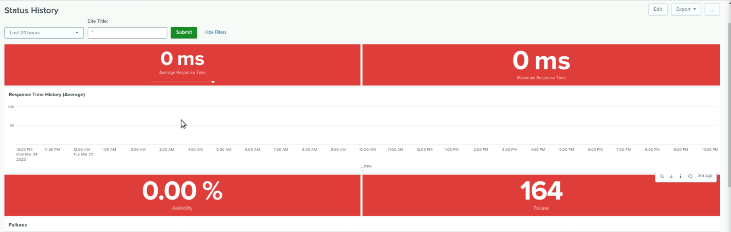
Website Monitoring
After finding the top ten reference domains using the Apache logs, we could use the website monitoring add-on app to create inputs of those domains that were used the most and monitor them, utilizing the different dashboards that are featured in the app. We could look at the Response time, connectivity failures to the domains, and availability of the domains.

Slide 8
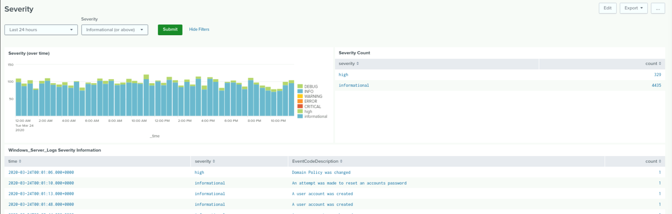
Website Monitoring
Another example, looking at the severity from the logs overtime, the count of each severity in the logs, and the list of severity and the description that went along with that severity

Slide 9
Logs Analyzed
Windows Logs
Apache Logs
1
2
The Windows event log analysis revealed security-related activities, including admin logins, privileged service calls, and user account changes, indicating active management or potential security concerns. Failed logins and account lockouts suggest unauthorized access attempts, while domain policy modifications and permission changes point to system security adjustments. Additionally, process termination and log clearing may indicate attempts to cover tracks, warranting further investigation into potential threats involving privileged access and log tampering
The Apache log captures HTTP request details from the VSI web server, including user agents (e.g., Mozilla Firefox, Googlebot), client IP addresses (e.g., 66.249.73.135), and referrer domains (e.g., google.com, stackoverflow.com). It logs various HTTP methods (GET, POST, etc.) and response status codes, such as 200 (OK), 404 (Not Found), and 500 (Internal Server Error). This log provides insights into traffic sources, client interactions, and potential server issues.

Slide 10
Windows Logs
‹#›

Slide 11
Reports—Windows
Designed the following reports:
Report Name | Report Description
Signature and Signature ID report | A report displaying the ID number linked to a specific Windows security event signature.
Severity levels report | A report providing a quick overview of Windows log severity levels, including the percentage difference between informational and high-severity events.
Success and Failure Status report | A report that detects suspicious levels of failed activities on the server while also displaying the success status of events.

Slide 12
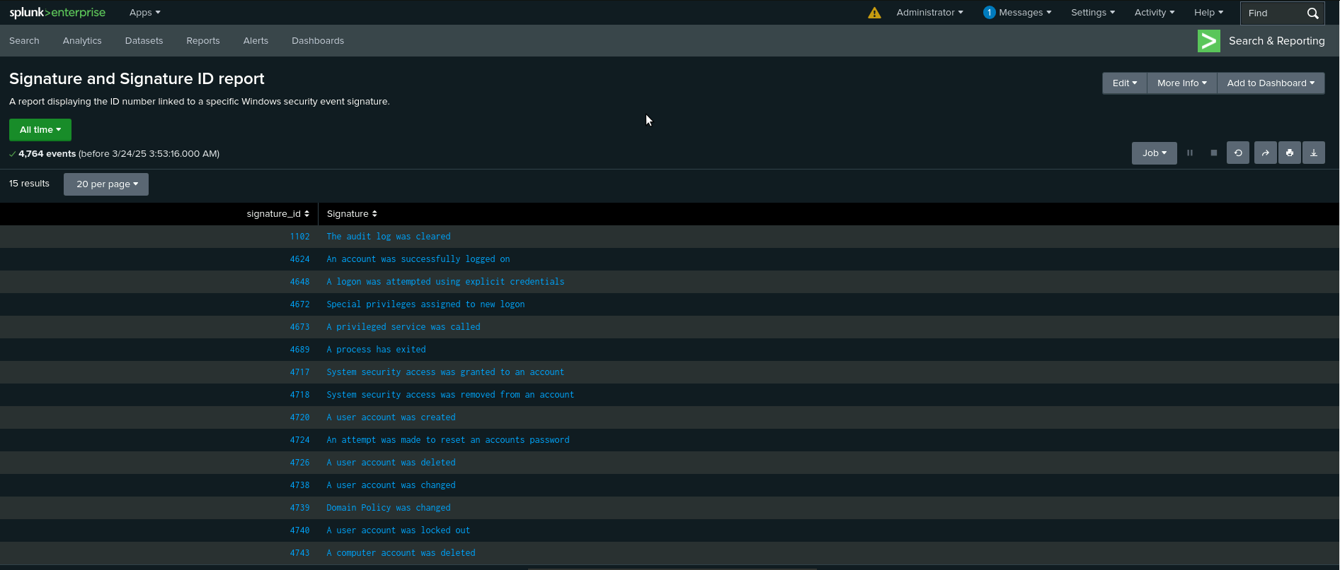
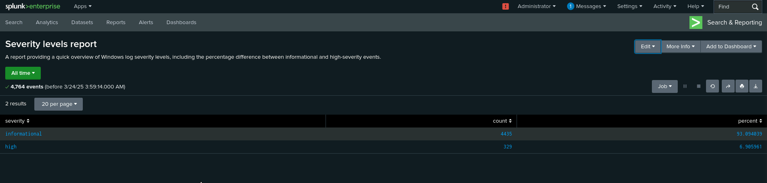
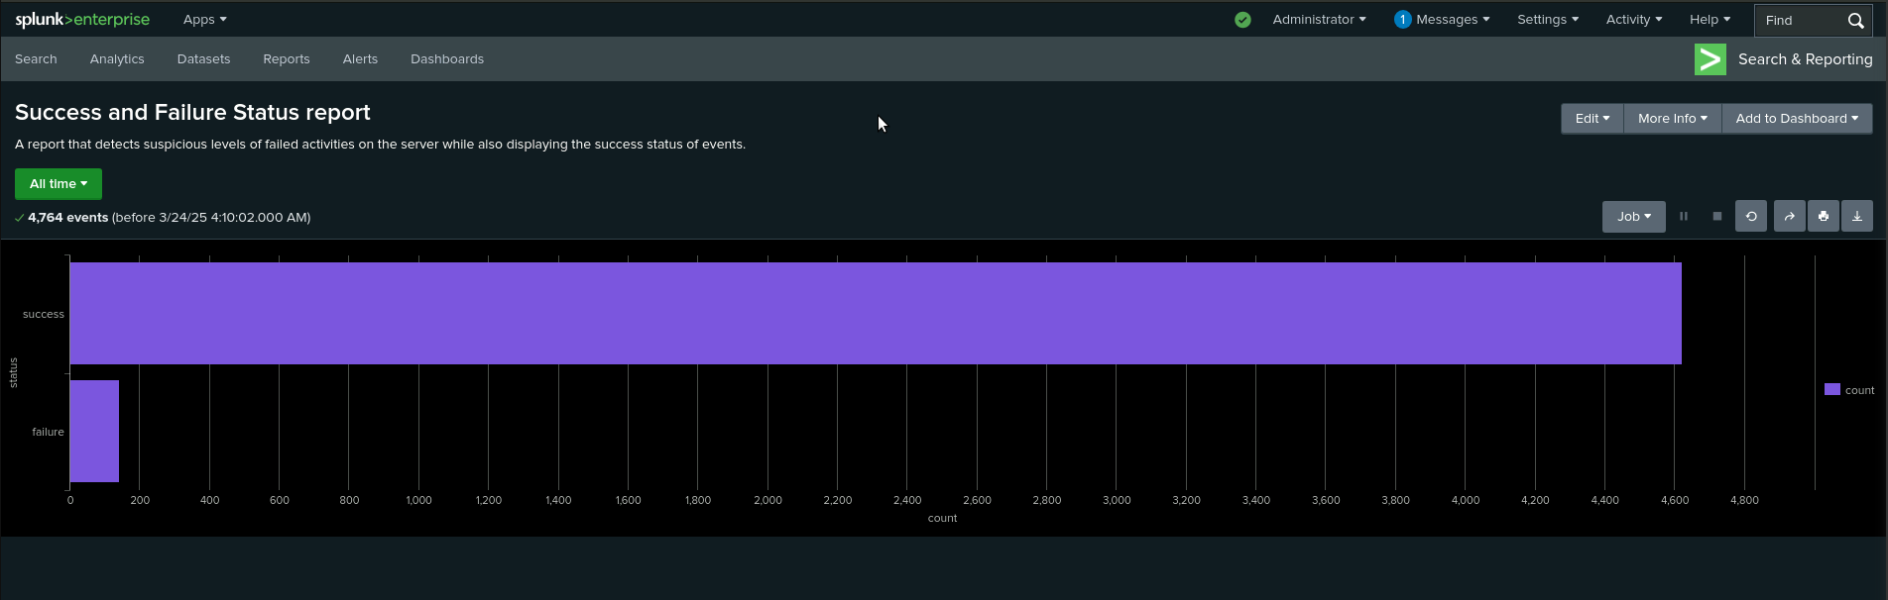
Images of Reports—Windows

Slide 13
Alerts—Windows
Designed the following alerts:
Alert Name | Alert Description | Alert Baseline | Alert Threshold
Failed Windows Activity Alert | The threshold of the failed Windows Activity | 6 | 12
JUSTIFICATION: The average for the alert baseline was around 6 failed Windows activity per hour and did not ever exceed more than 10 failed activities per hour so exceeding more than 12 failed alerts would deem suspicious activity.

Slide 14
Alerts—Windows
Designed the following alerts:
Alert Name | Alert Description | Alert Baseline | Alert Threshold
An account was successfully logged on alert | The threshold of a successful logon by user accounts | 12 | 27
JUSTIFICATION: The average for successful logins by user accounts is around 12 per hour with 21 logins being the highest amount of logins in 1 hour so I made the the alert threshold 27 logins per hour as that would raise concerns of suspicious activity.

Slide 15
Alerts—Windows
Designed the following alerts:
Alert Name | Alert Description | Alert Baseline | Alert Threshold
A user account was deleted alert | The threshold of a successful logon by user accounts | 13 | 30
JUSTIFICATION: The average for user accounts being deleted is 13 per hour so I determined that as my baseline then proceeded to set my alert threshold as 30 for each hour as that would cause concern for suspicious activity since the highest amount of deleted accounts never exceeded 22.

Slide 16
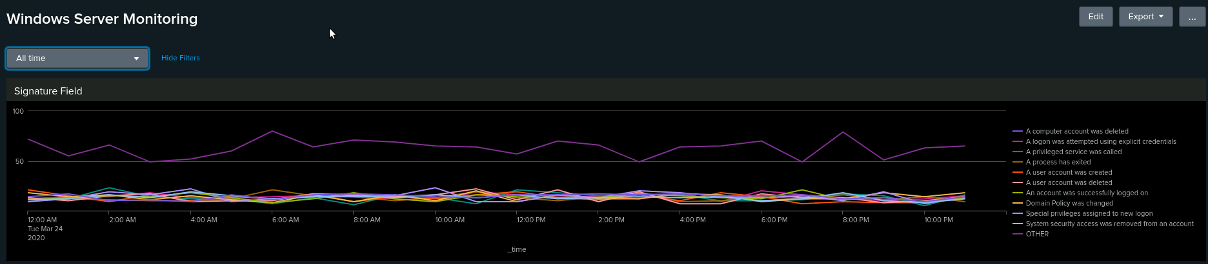
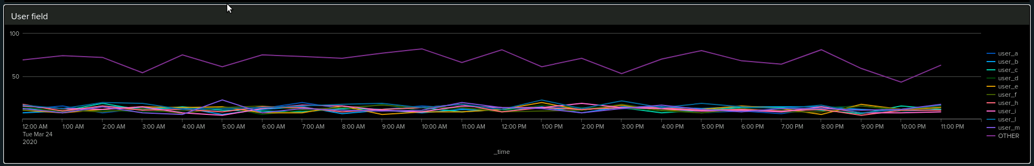
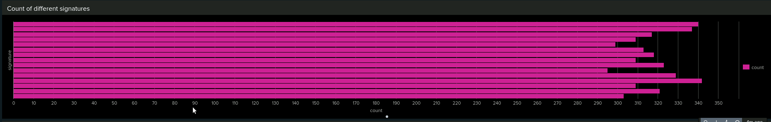
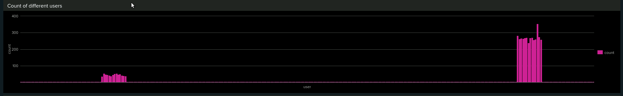
Dashboards—Windows

Slide 17
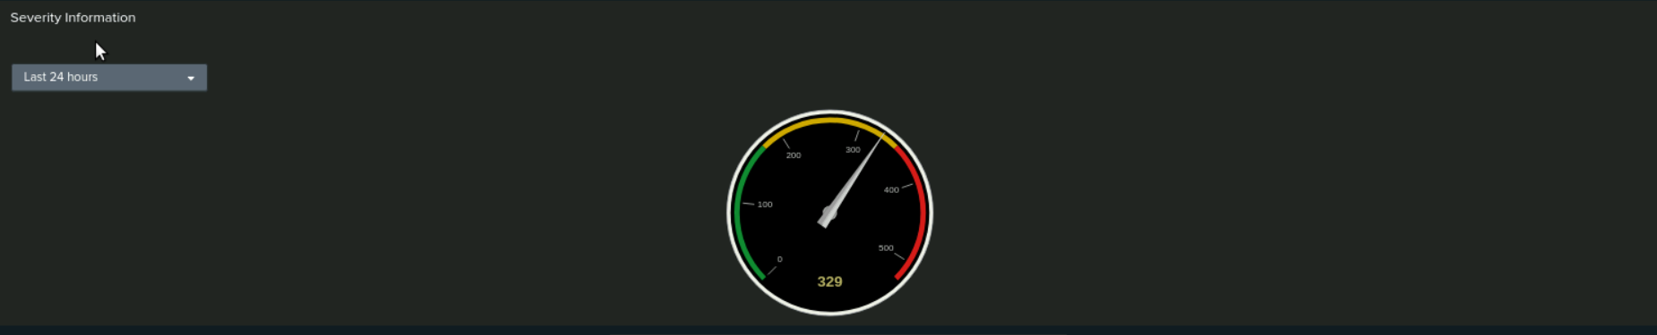
Dashboards—Windows

Slide 18
Apache Logs
‹#›

Slide 19
Reports—Apache
we Designed the following reports:
Report Name | Report Description
Different HTTP methods report | A report containing the different HTTP methods that have been requested by VSI's web server
Suspicious Domain’s report | The top 10 domain's for VSI's Apache web server to help identify suspicious domains.
HTTP response code count report | A report of the count of HTTP response codes that will provide insight into any suspicious levels of HTTP responses.

Slide 20
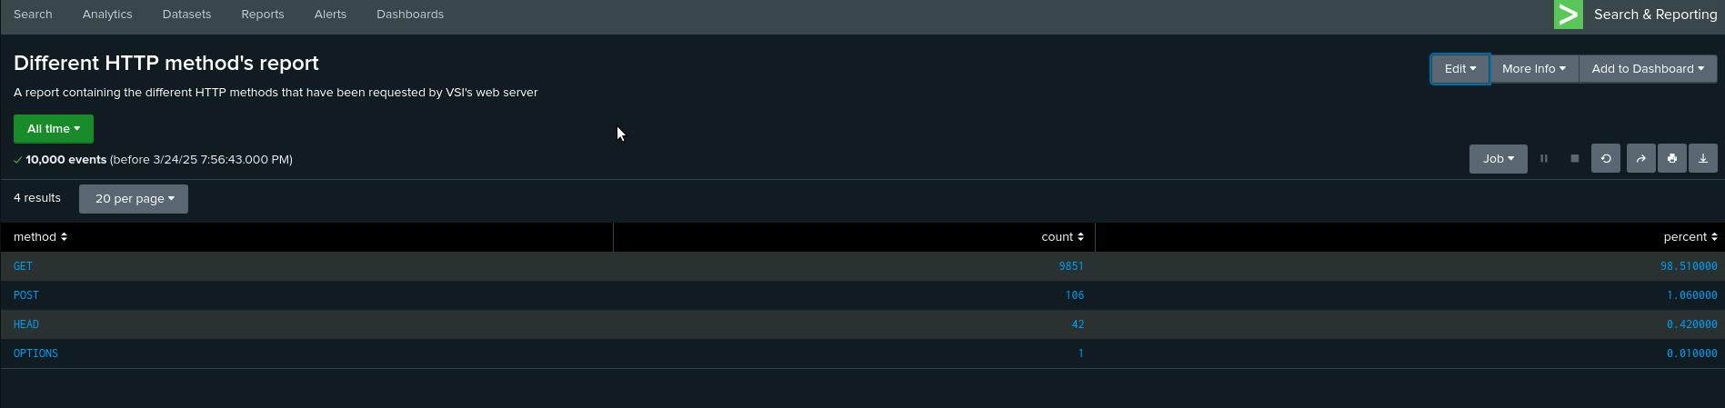
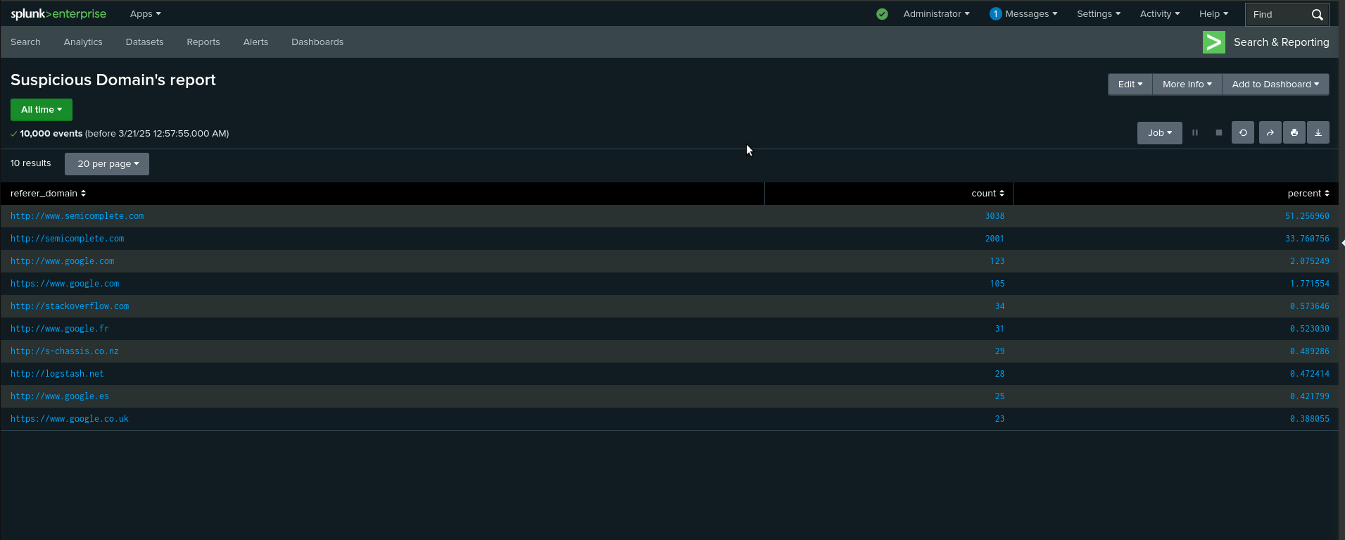
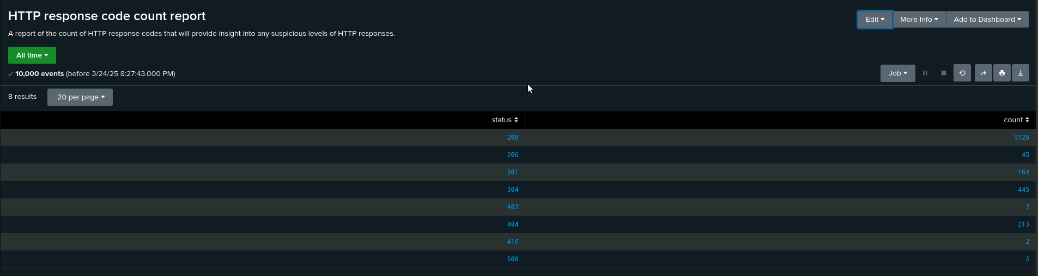
Images of Reports—Apache

Slide 21
Alerts—Apache
Designed the following alerts:
Alert Name | Alert Description | Alert Baseline | Alert Threshold
BaselineForHourlyActivityOutUSA | We have decided that the baseline for hourly activity outside of the US will be 90 logs per hour. | 90 | 110
JUSTIFICATION: After reviewing apache logs and filtering for events outside of the united states we feel comfortable setting at 90 event baseline with a 110 event threshold as any value greater than 110 would be cause for concern as it is anomalous.

Slide 22
Alerts—Apache
Designed the following alerts:
Alert Name | Alert Description | Alert Baseline | Alert Threshold
HTTP_POST_BASELINE | Baseline has been set to 3 HTTP POSTS per hour | 3 | 5
JUSTIFICATION: Upon reviewing the HTTP Post response methods per hour we have determined that 3 posts per hour is a justifiable baseline as most events fall between 0-4. We established our threshold at 5 as we believe anything that reaches that threshold is cause for concern

Slide 23
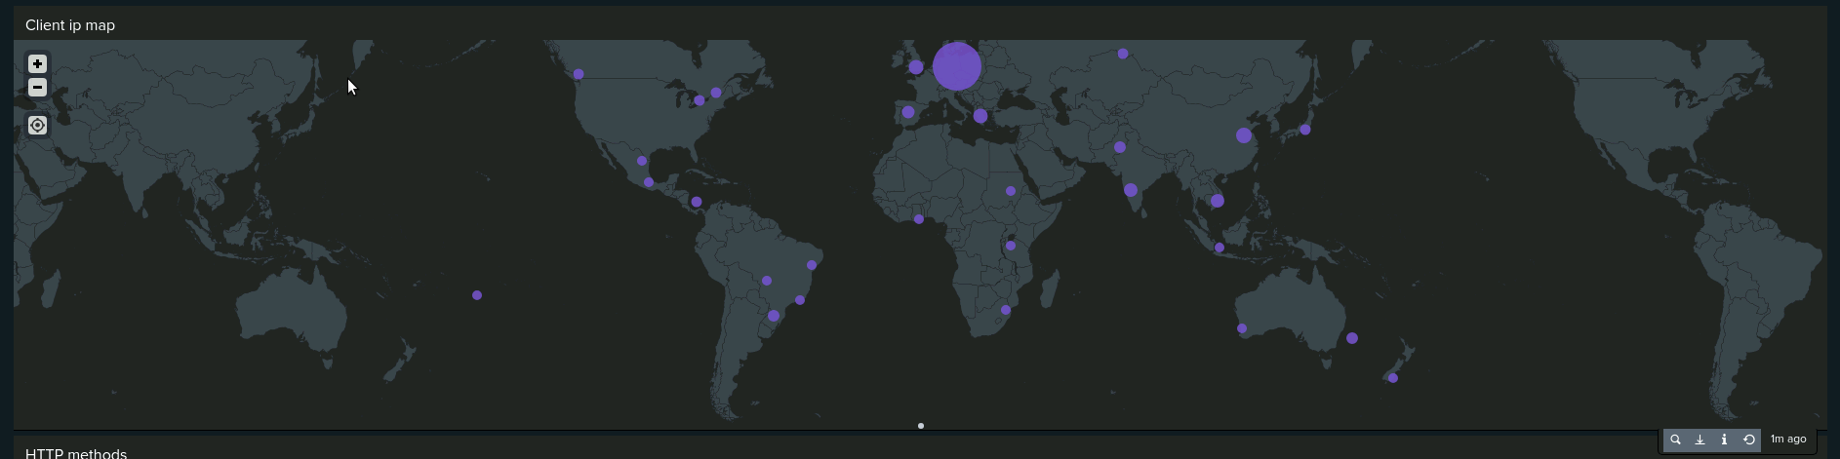
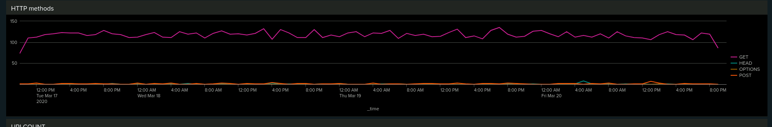
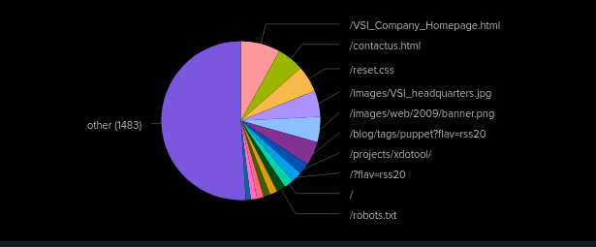
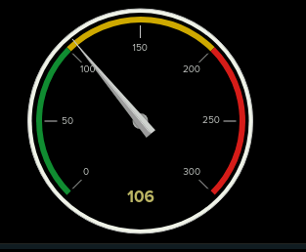
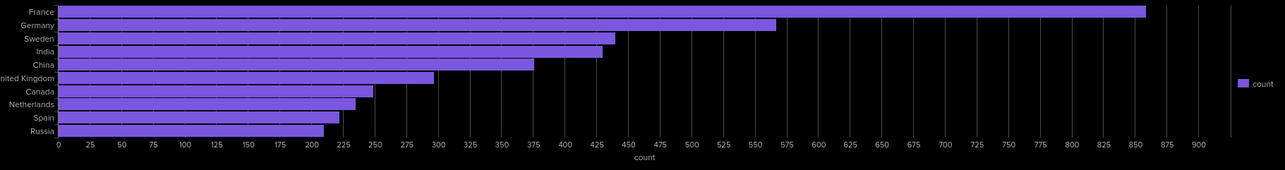
Dashboards—Apache
Place image here
Place image here
Place
Place image here

Slide 24
Attack Analysis
‹#›

Slide 25
Attack Summary—Windows
Summarize your findings from your reports when analyzing the attack logs.
Our analysis of the attack logs revealed a significant spike in High severity events, increasing by 782. Additionally, the Windows failed activities report showed fewer failures and more successful events, suggesting that the attacker gained increased access compared to normal Windows activity logs. This indicates a potential compromise with higher success in bypassing security measures.

Slide 26
Attack Summary—Windows
Summarize your findings from your alerts when analyzing the attack logs. Were the thresholds correct?
Our Failed Windows Activity alert showed a significant spike at 8 AM on Wednesday, March 25, 2020, with 35 events, surpassing the alert threshold of 12. Additionally, the successful logon alert flagged 273 logins for user_j between 11 AM and 12 PM, exceeding the threshold of 27. Since no anomalies were found in the user deleted alert, the analysis confirms that our alert thresholds were correctly set.

Slide 27
Attack Summary—Windows
Summarize your findings from your dashboards when analyzing the attack logs.
Analysis of the signature time chart revealed a sharp rise in account lockouts, successful logins, and password reset attempts, indicating a potential brute force attack with possible successful access. These events peaked at 1,258, 896, and 196 occurrences between 1 AM and 1 PM, with user_a, user_k, and user_j showing unusual activity surges. While bar, pie, and graph charts confirm these anomalies, they also suggest higher event counts than the time chart, highlighting potential discrepancies in the data.

Slide 28
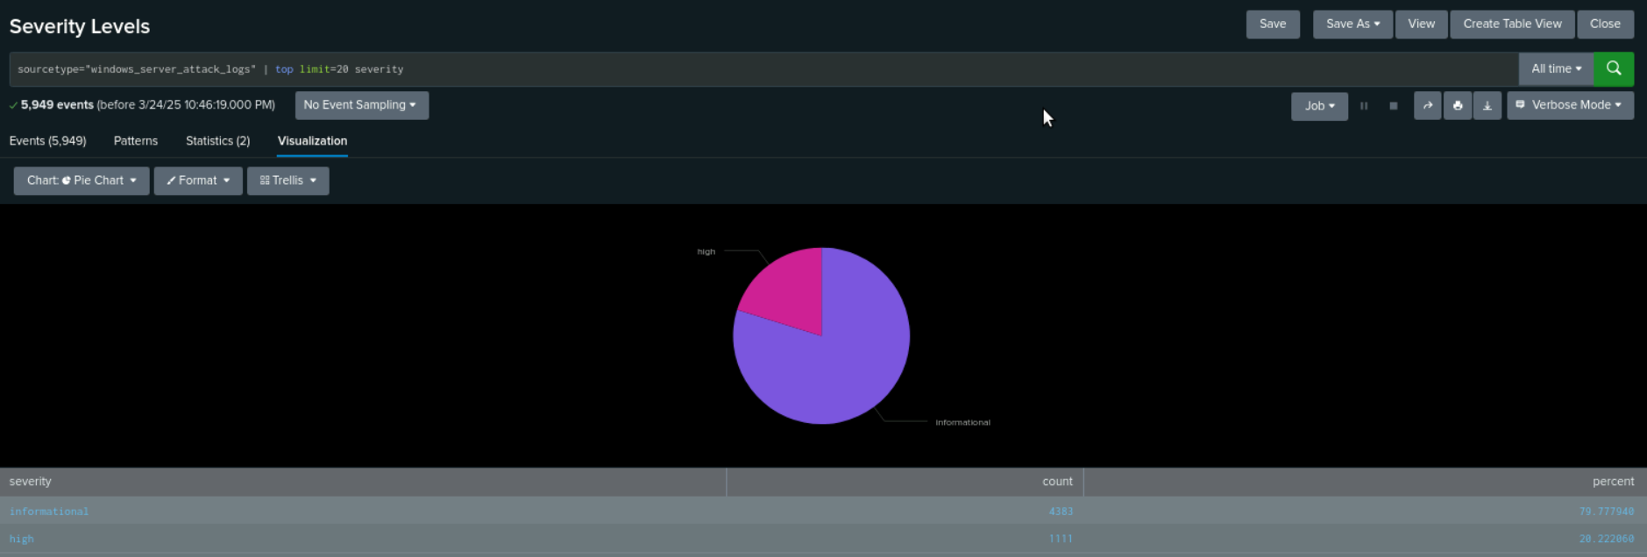
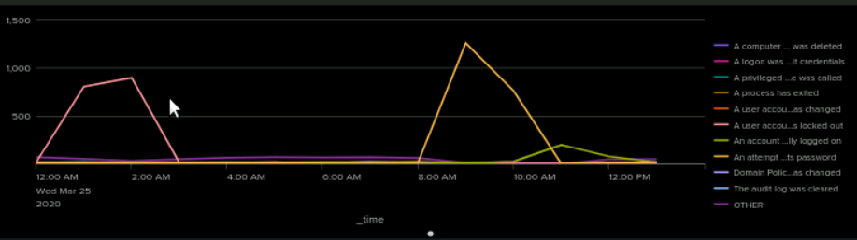
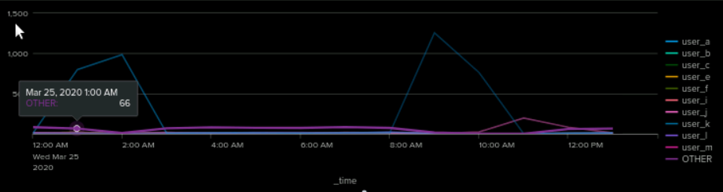
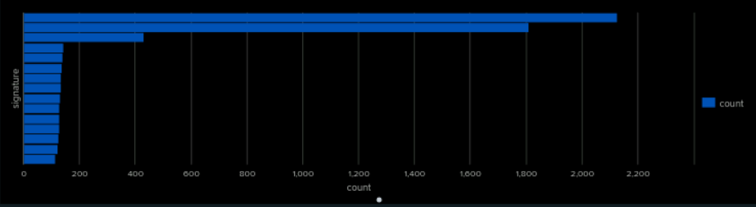
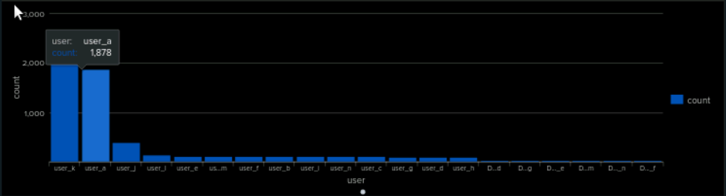
Screenshots of Attack Logs

Slide 29
Attack Summary—Apache
Summarize your findings from your reports when analyzing the attack logs.
There was a significant rise in HTTP POST requests in the Apache logs, which could indicate malicious activity since POST requests are used to send data to a server. Analyzing the referral domains showed no suspicious sources. However, a deeper look at response codes revealed a spike in HTTP 400 (Bad Request) errors and a drop in HTTP 200 (OK) responses. This pattern suggests possible brute force attacks, as repeated failed attempts to authenticate or interact with the server often lead to 400 errors.

Slide 30
Attack Summary—Apache
Summarize your findings from your alerts when analyzing the attack logs. Were the thresholds correct?
We detected a major spike in traffic from Kyiv and other regions in Ukraine, with 937 incidents in three hours—far exceeding our alert threshold of 110. This anomaly triggered an automatic alert, allowing for a swift response to mitigate potential risks. Similarly, our HTTP POST alert showed unusual activity, but since the threshold is only 5, the extreme increase suggests the threshold remains appropriately set.

Slide 31
Attack Summary—Apache
Summarize your findings from your dashboards when analyzing the attack logs.
An analysis of the Apache web monitoring dashboard showed a spike in GET and POST requests between 6:00 PM and 9:00 PM, with POST requests peaking at 1,296 during the suspected attack. A large portion of the traffic came from Ukraine, especially Kyiv, which recorded 438 events. The sharp increase in activity targeting the /VSI_account_logon.php endpoint suggests a possible PHP injection attempt, likely executed through an automated script.

Slide 32
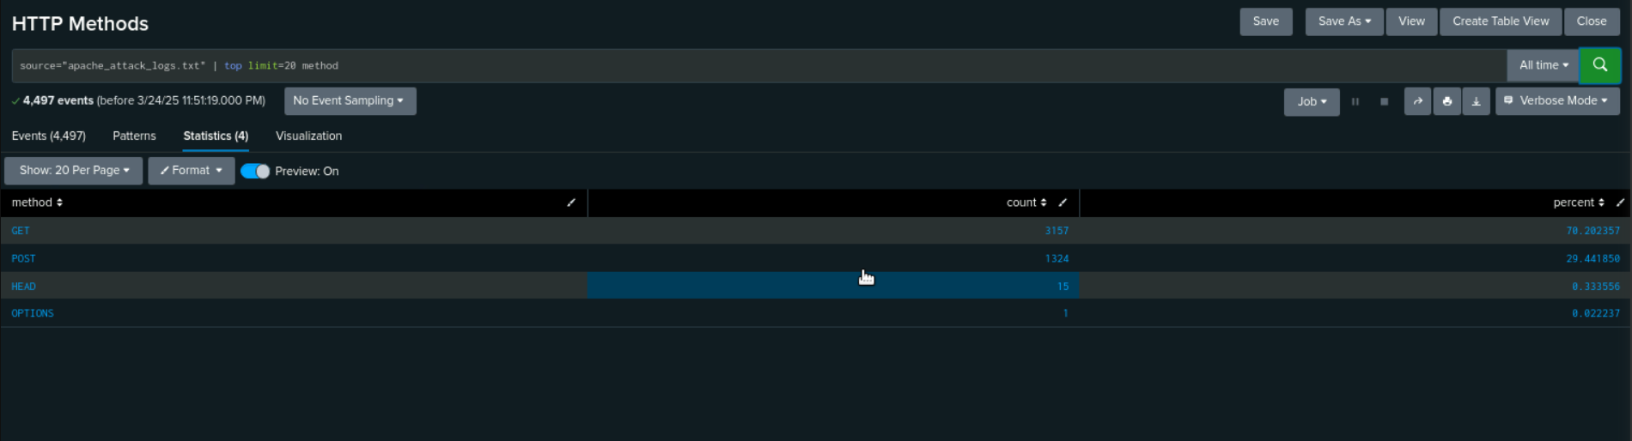
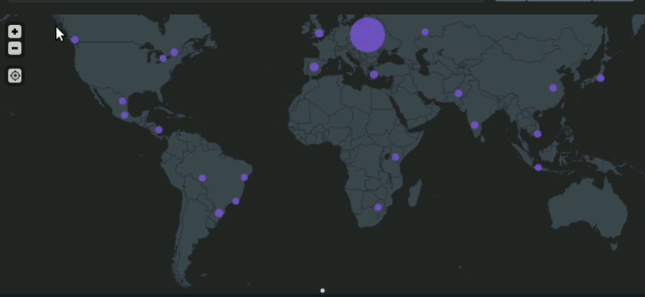
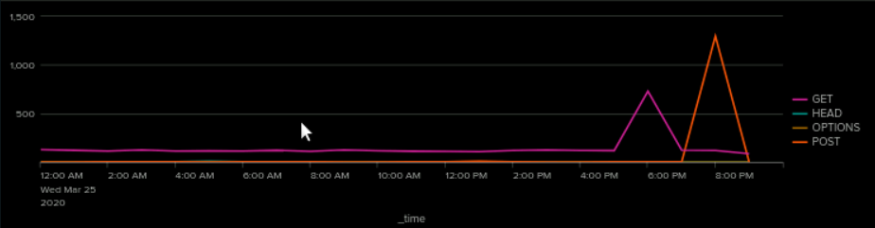

Screenshots of Attack Logs

Slide 33
Summary and Future Mitigations
‹#›

Slide 34
Project 3 Summary
What were your overall findings from the attack that took place?
The attack analysis revealed a surge in high-severity events, with 782 additional incidents. Windows logs showed a rise in successful logins, hinting at unauthorized access, especially with 273 successful logins by user_j between 11 AM and 12 PM. Indicators of a brute-force attack included spikes in "user account locked out" and "password reset attempts." Apache logs showed increased HTTP POST requests and errors, while traffic from Kyiv, Ukraine, spiked, exceeding alert thresholds. Web monitoring found a sharp rise in GET and POST requests, particularly targeting /VSI_account_logon.php, suggesting a potential PHP injection attack. Further investigation into PHP vulnerabilities is required.
To protect VSI from future attacks, what future mitigations would you recommend?
To protect VSI from future attacks, I recommend implementing multi-factor authentication, enforcing strong password policies, and using account lockout mechanisms. Enhancing log and alert monitoring, fine-tuning SIEM thresholds, and setting up real-time alerts for unusual events are also essential. Web application security should be improved with Web Application Firewalls, input validation to prevent PHP injections, and rate limiting on login endpoints. Restricting access from high-risk regions and using IP whitelisting will help mitigate unauthorized access. Additionally, deploying intrusion detection systems, patching vulnerabilities, and establishing an incident response plan will further strengthen security.

